Slide 1




Data
Culture
society
@edCDCS
Notes:
MT

Slide 2


Introduction to Text Analysis With Python
16 & 25 Feb 2026
Instructor: Joy Lan
Adapted from materials made by Xandra Dave Cochran
Notes:
MT

Slide 3


Recap
What is NLTK for?
How many tokens are in the following sentence? I ate the cake and she ate the cake too.
Can you name a form of normalisation of text for NLP? What does it do?
www.cdcs.ed.ac.uk

Slide 4
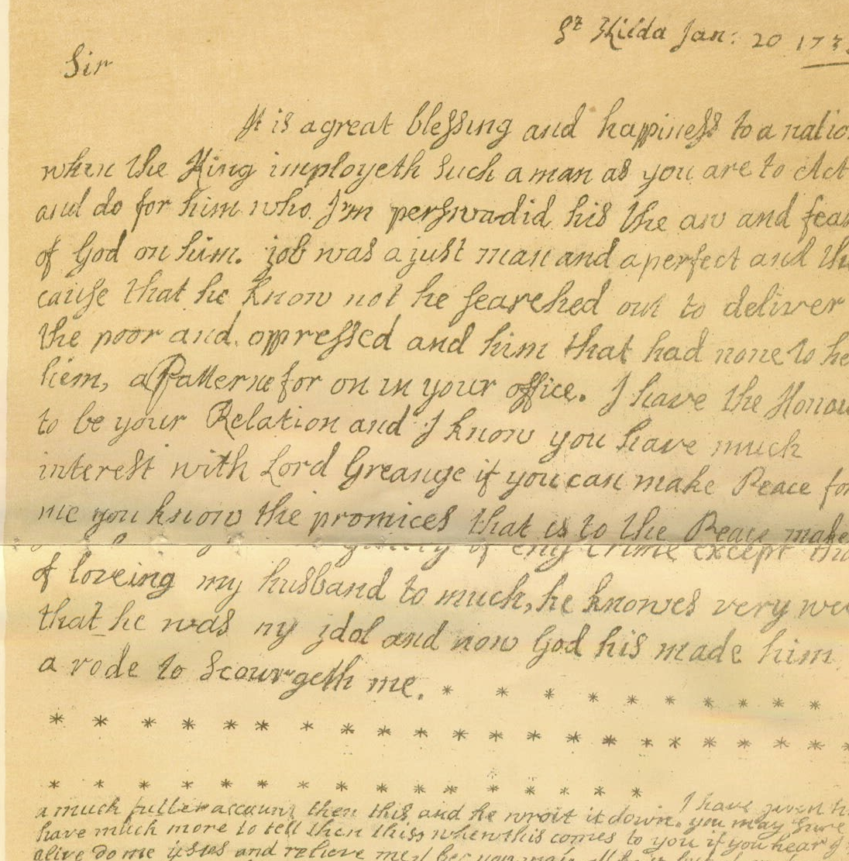
Week 2 Topics
Corpus Research with NLTK
Data Visualisation
Regular Expressions
Data Cleaning
www.cdcs.ed.ac.uk

Slide 5
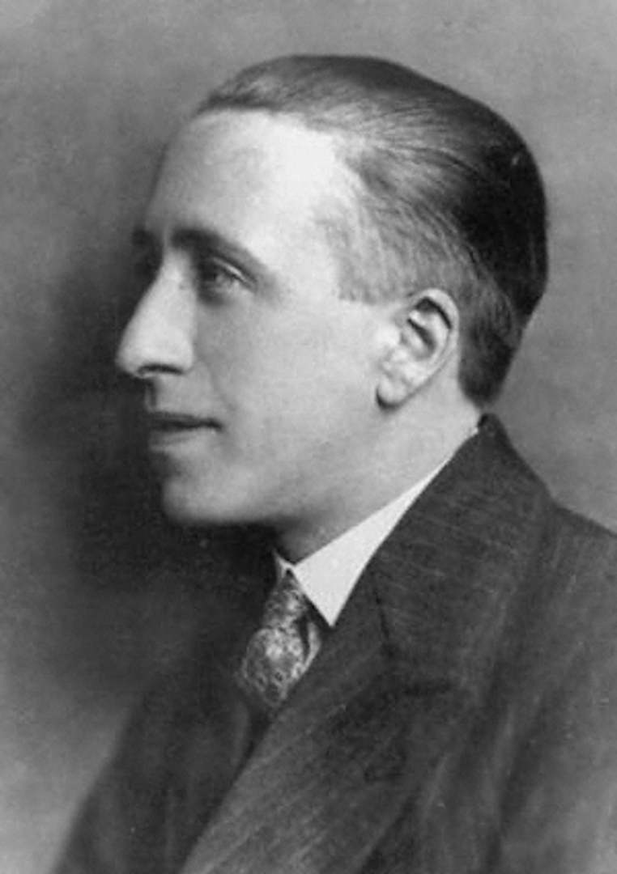
Corpus: Lewis Grassic Gibbon First Editions (National Library of Scotland)
Please Answer the following questions:
What are the most common words in the corpus?
What are the most common words in one book from the corpus?
How does the word choice of the author change from one book to another?
Note: Lexical diversity = count of unique words / count of all words
Research with NLTK
www.cdcs.ed.ac.uk

Slide 6


Slide 7
Let’s Code!

Slide 8
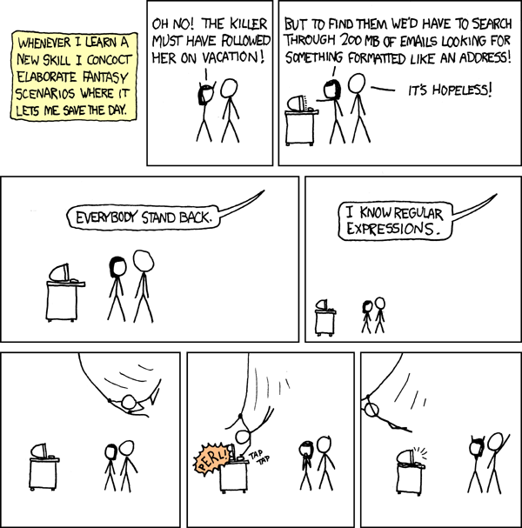
Regular Expressions (RegEx)
Pattern matching for the string (str) data type
Documentation:
Intro:
https://docs.python.org/3/howto/regex.html#regex-howto
Python re module:
https://docs.python.org/3/library/re.html
For practice:
https://regex101.com/
http://pythex.org/
Check out the Pythex cheat sheet!
www.cdcs.ed.ac.uk

Slide 9
Regular Expressions (RegEx)
To use in a Jupyter Notebook:
import re
To find patterns (2 ways):
re.findall("regex_pattern", "string_to_search")
["list", "of", "all", "matches", "found"]
p = re.compile("regex_pattern")
p.findall("string_to_search")
["list", "of", "all", "matches", "found"]
www.cdcs.ed.ac.uk

Slide 10
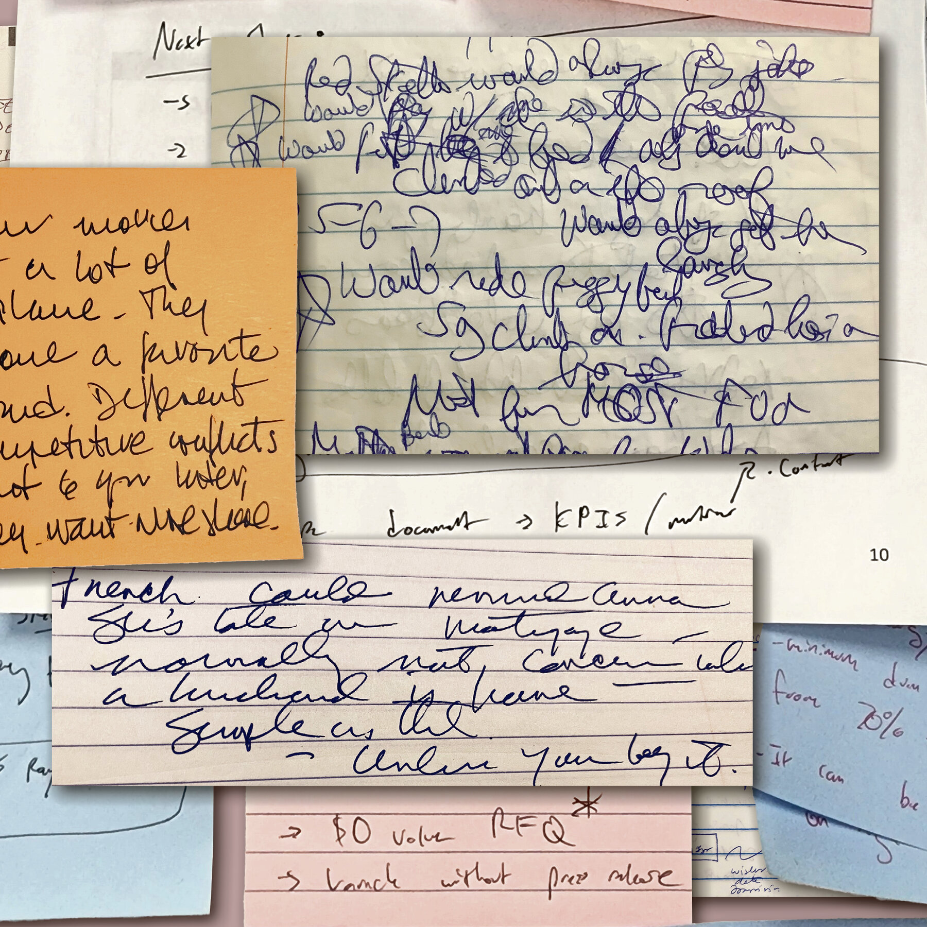
Cleaning Messy Text
Remember, digitization is imperfect
• Includes OCR (optical character recognition)
• Includes HWT or HRT (handwriting recognition)
Besides Regular Expressions, you can use…
s.strip() - remove leading & trailing whitespace or input characters in string s
s.replace(‘a’, ‘b’) - replace a with b in string s
www.cdcs.ed.ac.uk

Slide 11

Beware!
Be careful not to spend all your time cleaning data! It may be useful to time-box this task so that you do not run out of time for the actual analysis work.
Alternatively, you could consider investing in or applying for funds to manually correct your text. This will yield more accurate results than programmatic methods.
www.cdcs.ed.ac.uk

Slide 12
Let’s Code!

Slide 13
Text Analysis: NLTK & Beyond
Training Pathway for Text Analysis
https://www.cdcs.ed.ac.uk/training/training-pathways/text-analysis-pathway
Sentiment Analysis Tutorial in Jupyter Notebooks
Includes cleaning up text! Uses an NLTK tool called VADER for sentiment analysis
https://github.com/DCS-training/SentimentAnalysistimes
Text Analysis with Constellate
Uses Jupyter Notebooks and libraries other than NLTK
https://github.com/ithaka/constellate-notebooks
Topic Modelling with BERT
Uses Jupyter Notebooks and BERT, a transformer-based LLM. Will be delivered by me on 28th Feb–7th Mar this semester
https://www.cdcs.ed.ac.uk/events/intro-topic-modelling-feb25
W3Schools - Python, RegEx, and much more!
https://www.w3schools.com/
www.cdcs.ed.ac.uk

Slide 14
Thanks Everyone
Please message me on Teams for office hours!

